Slide 1

Software Project Risk Management
Submitted By
Almas Fatima
7th “B”
Submitted To
Ma’am Ayesha
BSCS-F19-M-71

Slide 2
INTRODUCTION
Risk Management:
Risk management is concerned with identifying risks and drawing up plans to minimize their effect on a project.
A risk is a probability that some adverse circumstance will occur
Project risks affect schedule or resources
Product risks affect the quality or performance of the software being developed
Business risks affect the organization developing or procuring the software.

Slide 3
Name | Year | Method | Conclusion
Nidhi Sehrawat , Neha Munsi , Mahak Jain | 2014 | Estimation | But the studies shows that these disasters would have been avoided or strongly reduced if there had been an explicit early concern with risk management. the paper deals with risk management, risk identification approaches , risk impact definition. Software risk management is a continuous process rather than sequential activity.
Kevin MacG. Adams, C. Ariel Pinto | 2005 | Journals And Other Research Paper | A review of the principal software engineering scholarly journals and the body of knowledge reveals few papers that discuss methods and techniques for implementing risk management and/or analysis on software development projects. It is noteworthy that most of the papers deal with approaches, models, methods and frameworks and very few deal with the factors surrounding risk management implementation on software projects. The analysis also shows that the SWEBOK places a heavy emphasis on implementation of risk management in software projects but that these papers, papers that represent the best submissions on software project risk management/analysis, have not received sufficient attention and do not appear to be widely accepted within the software engineering community.

Slide 4
Name | Year | Method | Conclusion
Sandra Miranda Neves | 2016 | Bulk of Research , Diagnostic Study | Regarding trends in the literature evaluated, it appears that the studies are primarily focused on identifying risk factors , a recurring theme. However, we perceive that the authors are concerned with establishing both the dynamics of the software development environment, which can quickly outdate the work in this area, and the culture of the country where the study is conducted, which allows the emergence of further studies on this theme. The lack of research on this subject in some journals that focus on research on micro and small enterprises also suggests more studies to be conducted.
Linda Westfall | 2008 | Scrum | Adopting a Software Risk Management Program is a step every software manager can take to more effectively manage software development initiatives. Risk management is an ongoing process that is implemented as part of the initial project planning activities and utilized throughout all of the phases of the software development lifecycle. Based on a positive, proactive approach, risk management can greatly reduce or even eliminate the need for crisis management within our software projects.

Slide 5
Methadology
This research uses survey methodology with non-probabilistic purposive sampling to:
Data Collection
Data Analysis
Demographic Profile
Organization Type
Project Type
Project Budget Allocation

Slide 6
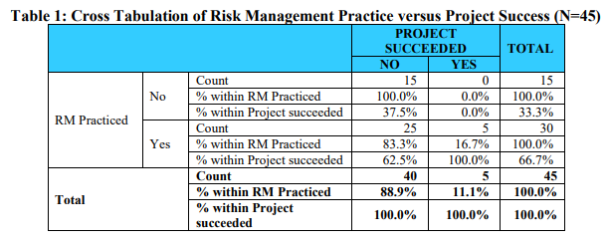
Discussion

Slide 7
Conclusion
Risk management is an important component of software project management. However, much has not been said on risk management practice in the DC; to the best of the authors' knowledge, none in the Ethiopian context. A very low adoption of formal risk management models was observed in this study. This may not be unexpected, as the development of information systems is in its infancy stage in Ethiopia and so can be software risk management. However, an important finding was obtained in this study in relation to project managers' perception of risk management practice. Another key finding of this study was uncertainties by project managers on whether risk management processes were carried out in the project implementation or not. This reveals a gap in the ability of project managers to adequately manage projects. Factors affecting effectiveness of project management in the Ethiopian context can be an opportunity for future studies. Investigation of risk management knowledge and perception of project managers can be an opportunity for future work. Also, studies on factors that are affecting the level of adoption of formal models and practice of risk management in general can contribute towards a full picture in the topic.

Slide 8


